Slide 1
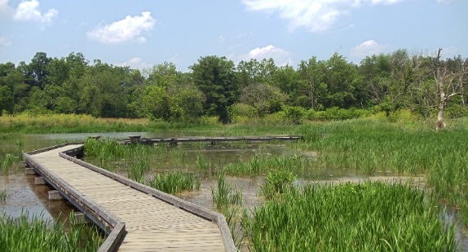
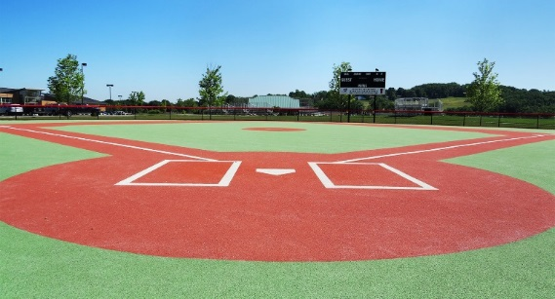
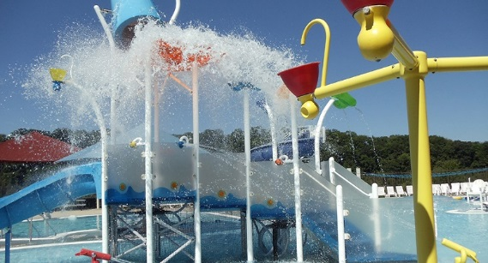
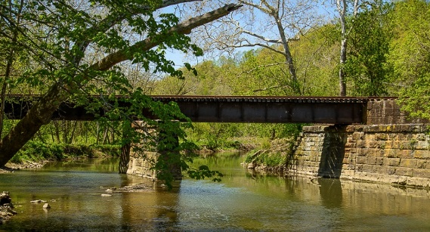
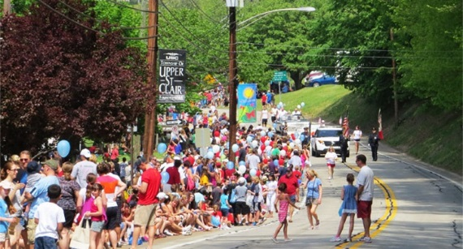
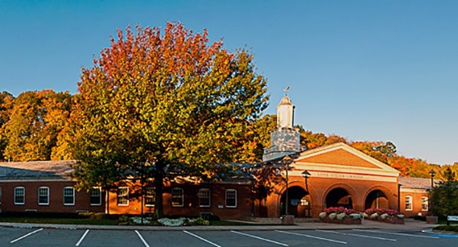
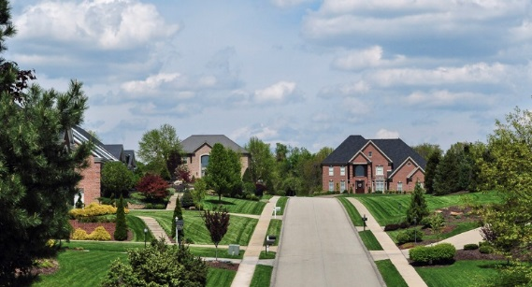
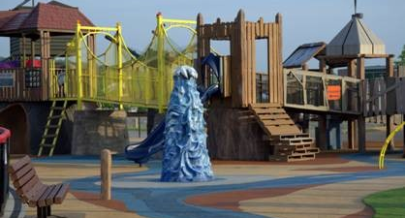
Upper St. Clair
Investing In Our Quality of Life
2015 – 2025

Slide 2
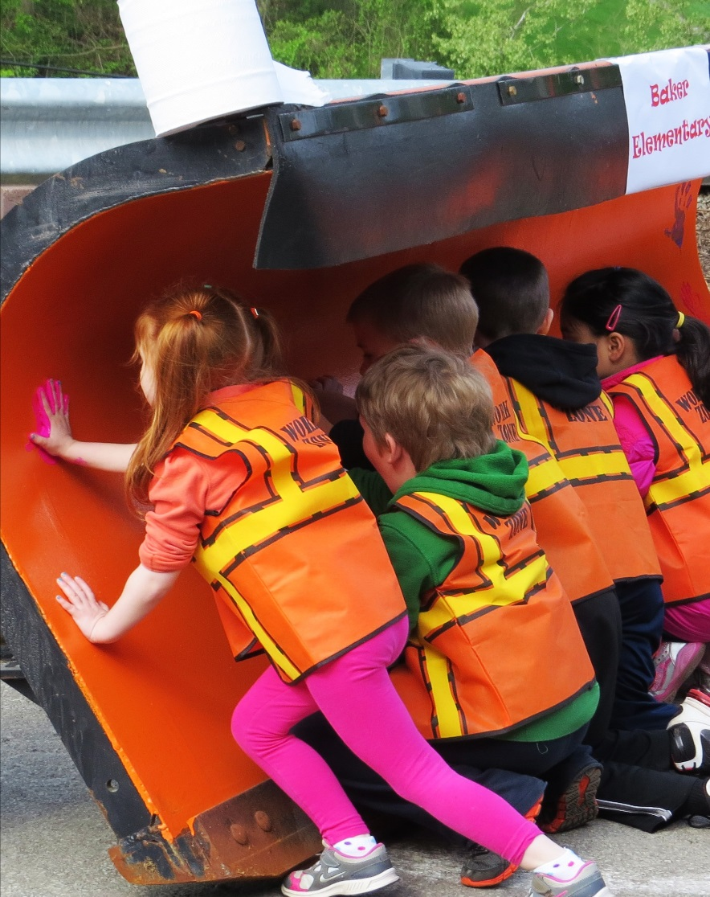
What makes Upper St. Clair different from other communities?
The reasons are many and meaningful.
Upper St. Clair is a composition of:
Respectful Families of All Ages and Sizes
Dedicated Local Businesses
Quality Civic Spaces
Analytical, Responsive Leadership and Administration
Decision Makers
A Balance of Tradition and Innovation
Upper St. Clair is unique because of you.

Slide 3
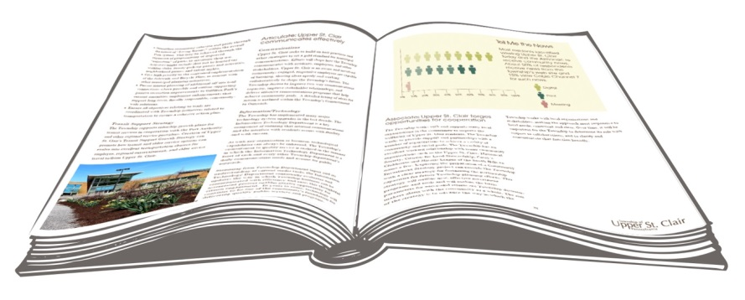
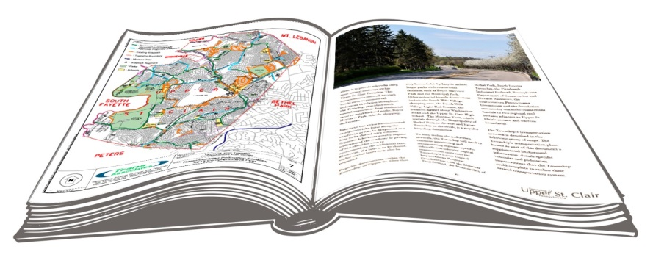
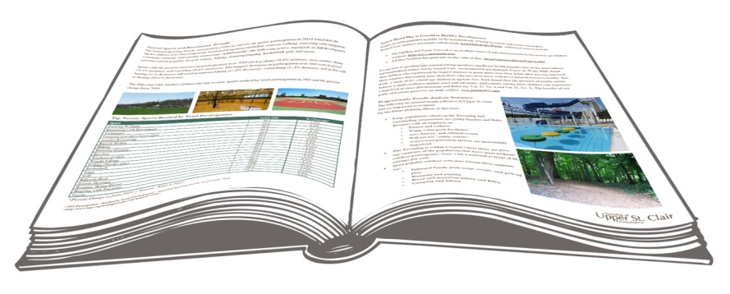
Facets of Planning in Upper St. Clair
Planning in
Upper St. Clair
Comprehensive Plan
Park and Recreation Plan
Quality f Life, Land Use, Infrastructure,
Civic Amenities, and Outreach Updates
Transportation/Connectivity Update

Slide 4
Highlights of the Refinements to Date *
* August to September 2015 refinements requested are incorporated into the public review draft
Clarified aspects associated with quality of life in context of intersection improvements
Clarified municipal involvement in public areas of suburban woodlands
Identified the broader nature of assessing opportunities for infill development prior to executing infill development strategies
Re-casted a broader net/classifications to capture ways in which elements of sustainability could be identified
Identified the Township as place in which outreach (of various kinds) for regionally significant infrastructure impacts, etc. can occur.
Clarified local organizations and surrounding communities include private and public entities
Removed references to “scoring” priorities for development, etc.
Reinforced that Pedestrian and bicycle safety education is a component of several departments and there are on-going opportunities for discussing it
Noted that recommended road intersection and segment projects are identified in priority order
Provided additional references to feedback/quality of life survey results in various portions of the document as applicable
Noted the ideas and recommendations of the focus group were incorporated into the recommendations of the plan as a whole
Refining/completing sentences as applicable for formatting/needed editing; maps relocated within document as applicable

Slide 5
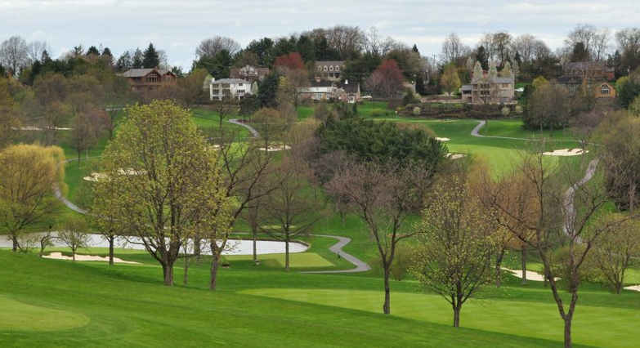
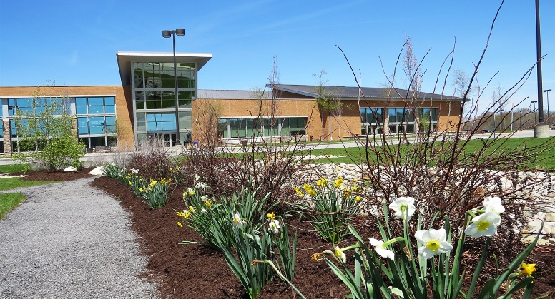

Comprehensive Planning Goals
Continue offering residents a great place to live, learn, and play.
Maintain efforts to be a readily identifiable and distinctive suburban Pittsburgh Community.
Cultivate responsibility.
Offer everyone a safe, clean, and friendly environment.
Lead by example among all Township Departments applying sound community planning, values, and communication

Slide 6
Commitment to Responsibility
Coordinated Future Land Uses and Housing
Public Services, Public Safety, and Municipal Department Excellence
Stormwater Management
Suburban Woodlands
Township Sustainability
Natural Heritage System
Library Programs and Services
Recreation, Parks and Culture
Transit Support Strategy
Information/Technology

Slide 7
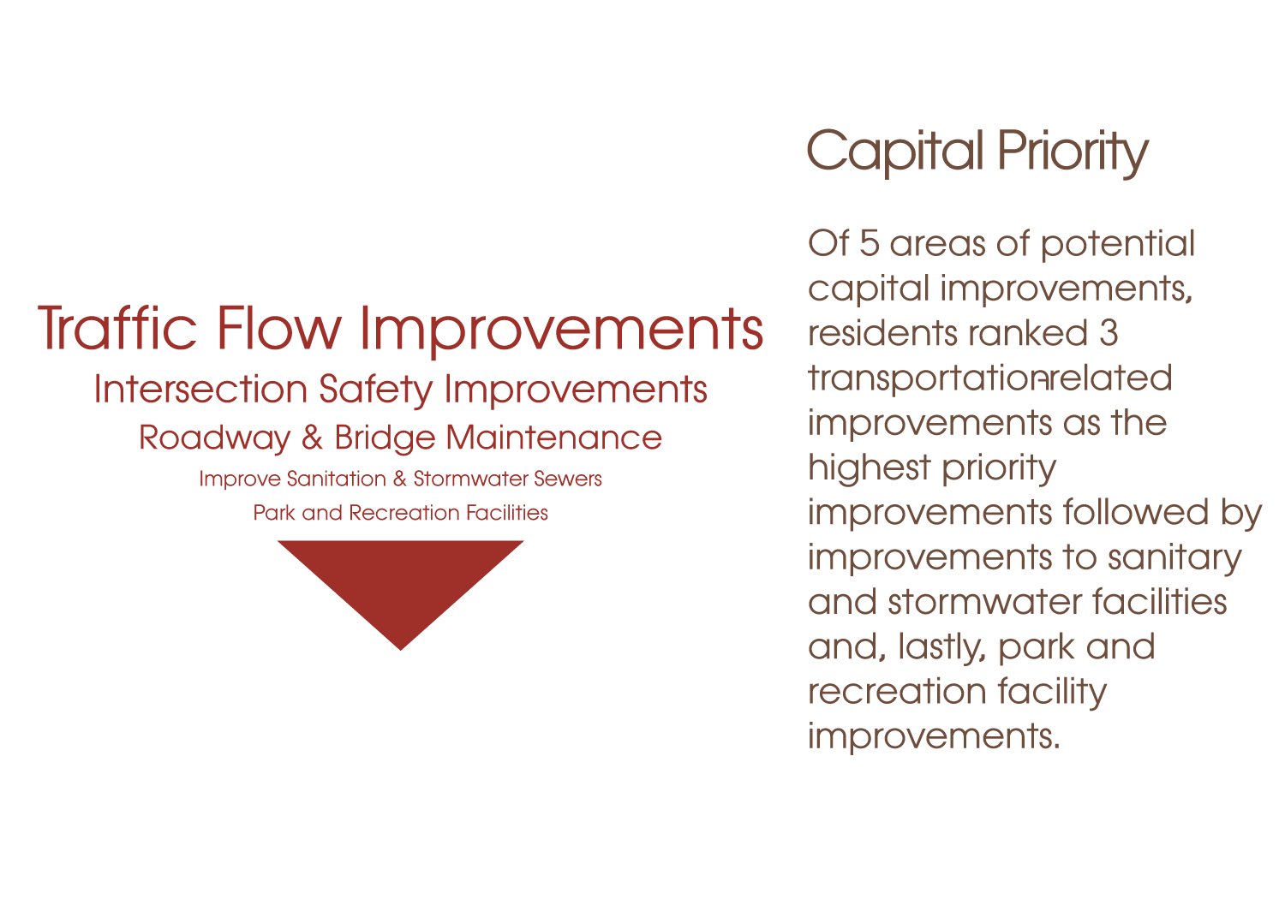
Commitment to Connectivity
The Township’s commitment to connectivity has two equally important and complex parts: improvements for its vehicular road network and expansion of its pedestrian system.
Intersections of Focus for Connectivity Progress
Washington Road with Fort Couch Road
Washington Road with Boyce Road
Bethel Church Road with Drake Road
Painters Run Road with McMillan Road
Painters Run Road with Robb Hollow Road
McMurray Road with Bethel Church Road
Washington Road with Circle Drive

Slide 8
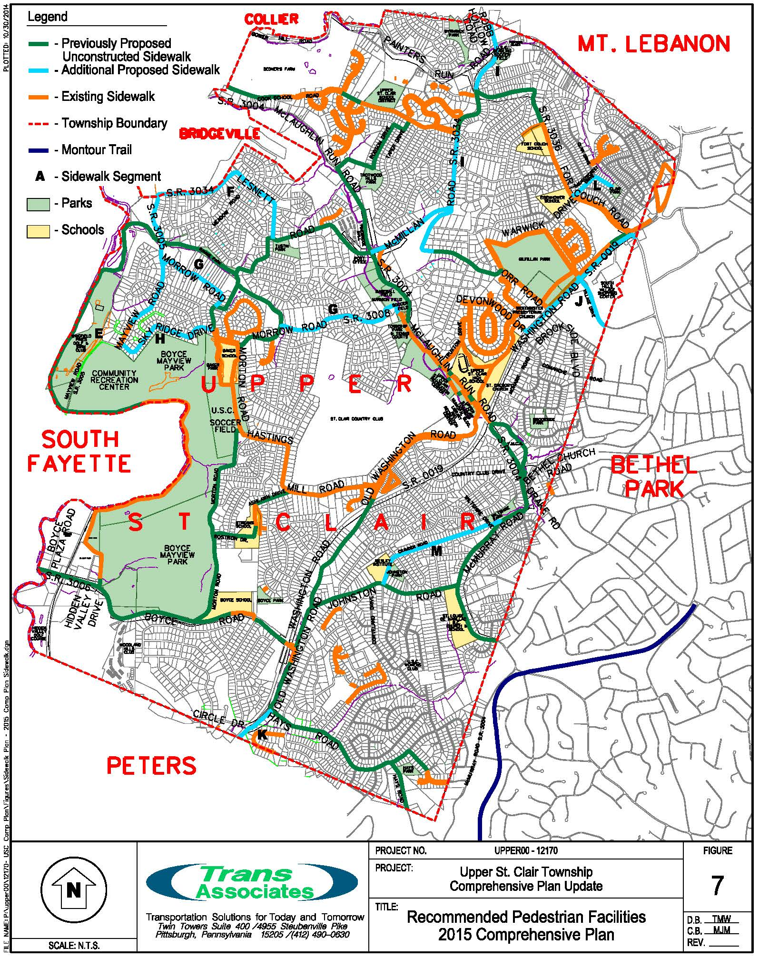

Slide 9
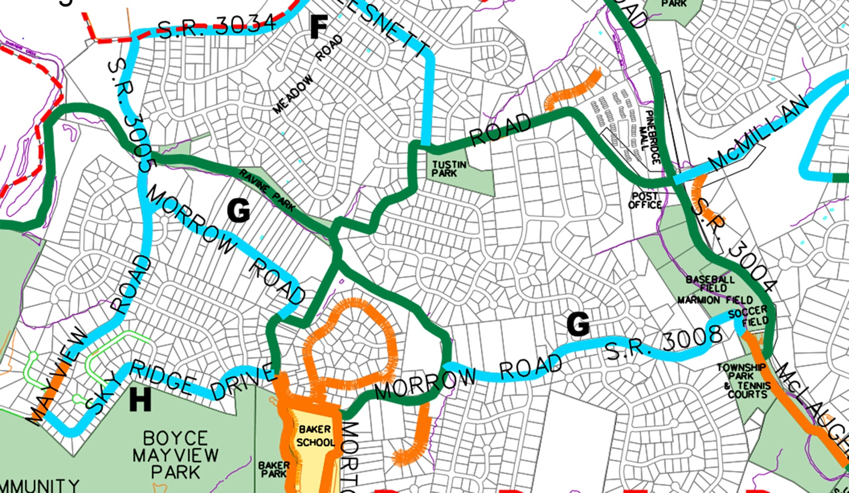

Slide 10
Commitment to Outreach
To provide a framework to enhance the Township’s two-way communications capacity, improve stakeholder relationships, and deliver effective communications programs that help achieve organizational goals, the Township seeks to:
Provide information that is timely, accurate, clear, accessible and responsive.
Consider the wide range of communication tools available and use those most appropriately to address the needs associated with each circumstance.
Work collaboratively across administration and staff to ensure that information is thorough, factual and timely.
Respect the access to information and privacy rights of citizens and employees.
Support opportunities for engagement to inform public policy.
Strive to achieve a culture of two-way communication and communications excellence practices.

Slide 11
Commitment to Civic Space
The Outlook of the Township’s Civic Space effort is to enhance and assure the quality of life of Township residents by providing a diversity of: safe, accessible, culturally based, family-oriented, well maintained and/or protected, economically responsible, and strategically located amenities.
Strategic Focuses to providing Quality Civic Spaces:
Programming
Community Awareness
Strategic Alliances

Slide 12
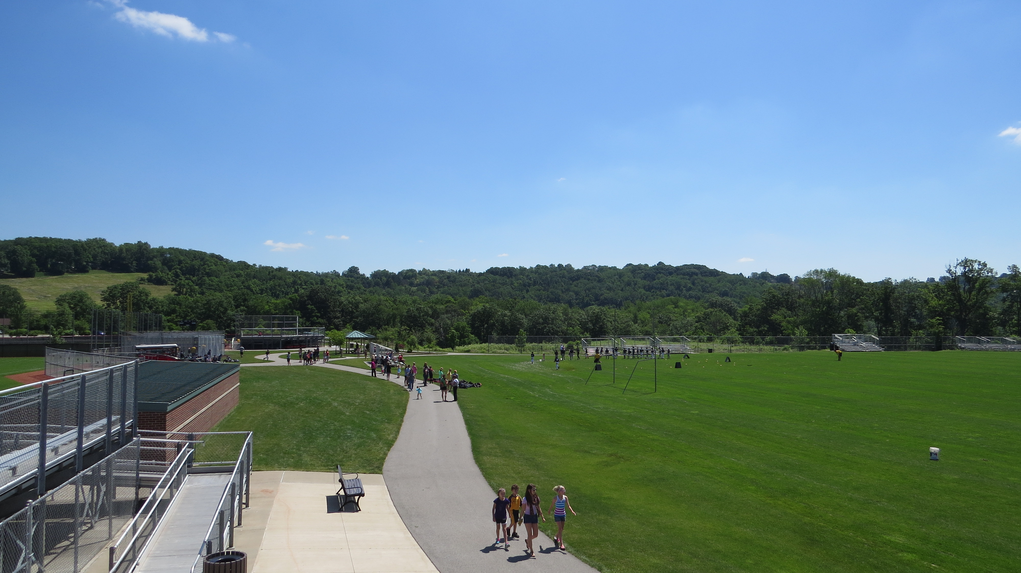
An Action Plan: Moving Forward
Land Use, Housing, and Development
Infrastructure and Transportation
Civic Space
Local Government and Services

Slide 13
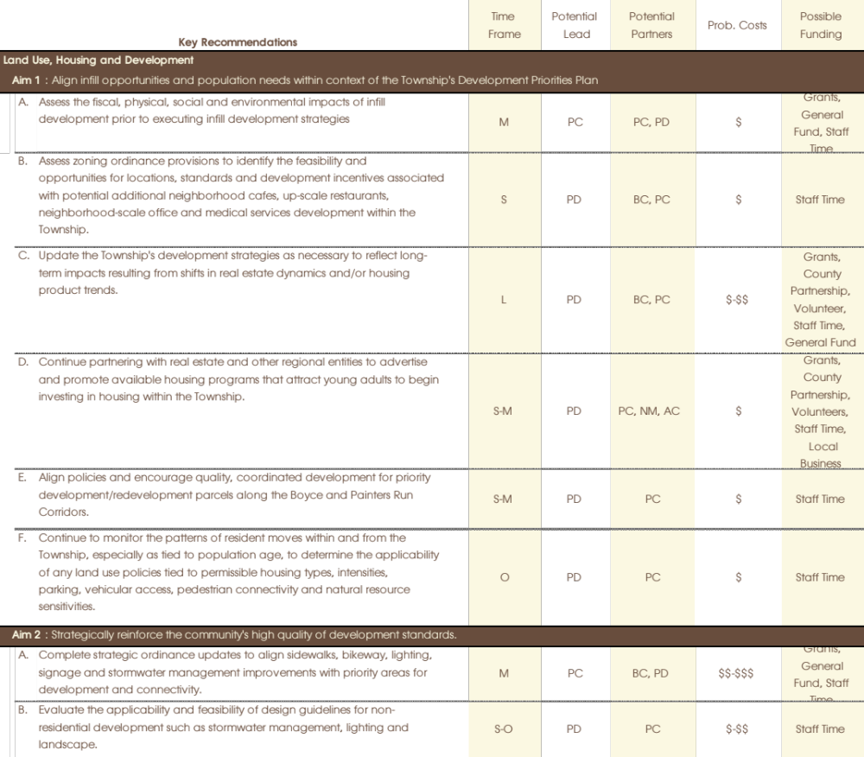

Slide 14
Land Use, Housing and Development
Assess impacts of infill development
Continue to support existing patterns of zoning; consider zoning for potential eating establishments, offices and services; update Township development strategies as applicable
Complete strategic ordinance updates for priority areas of development and connectivity
Continue to monitor patterns of residential moves; partner with real estate and other regional entities to promote young residents investing in the community
Align policies for priority areas of development along Boyce and Painters Run corridors
Evaluate applicability and feasibility of design guidelines
Create capabilities for on-line development application submission and Township Commission access/review

Slide 15
Infrastructure and Transportation
Develop webinars/anytime sessions regarding educational outreach re: regional stormwater
Prepare re-occurring on-line and USC Today highlights regarding completed infrastructure improvements
Share ‘lessons learned’ regarding sustainable practices/efficiencies
Prioritize and allocate resources for roadway and key intersection improvements
Prioritize and pursue sidewalk and bikeway improvements
Promote pedestrian and bicycle safety
Coordinate with community and regional officials regarding multi-municipal improvements

Slide 16
Civic Space
Address Township-prioritized improvements
Provide library spaces, programs and services relevant to those of all ages and interests
Maintain a healthy tree canopy and understory; promote coordinated conservation of the landscape within the public realm
Continue to implement updated stormwater and floodplain management initiatives.
Evaluate the feasibility and prioritize facility update needs for Township public spaces/sites/structures
Consider opportunities of expanded recreation and public spaces as applicable

Slide 17
Local Government and Services
Develop a framework tracking Township service excellence
Outline and implement a coordinated communications strategy
Organize and expand opportunities for collaboration with the School District
Conduct on-line and/or in-person get-togethers to discuss factors and amenities that contribute to Township quality of life
Create a bi-annual Progress Report to self-evaluate Action Plan status
Evaluate Township Department annual needs and identify short-and long-term needs
Continued to align technology needs with delivery of Township services

Slide 18
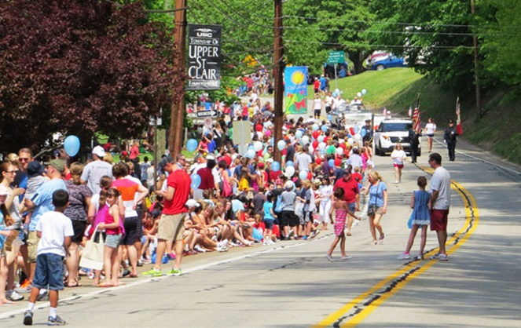
Thank you
for being you.

Slide 19
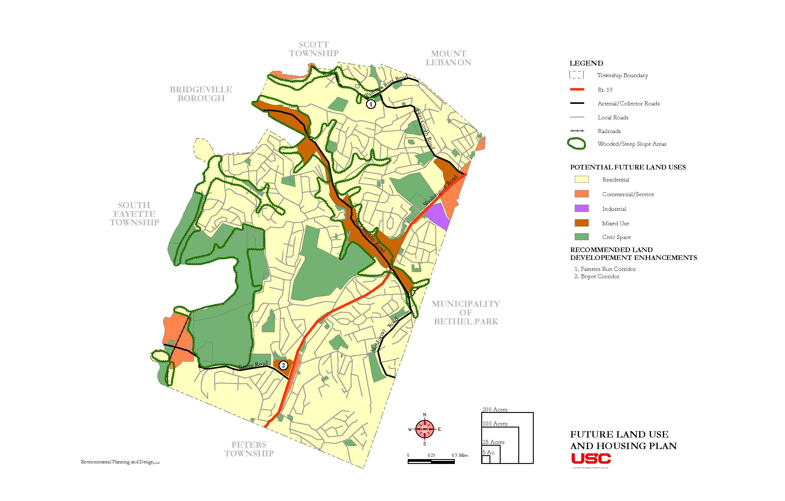

Slide 20
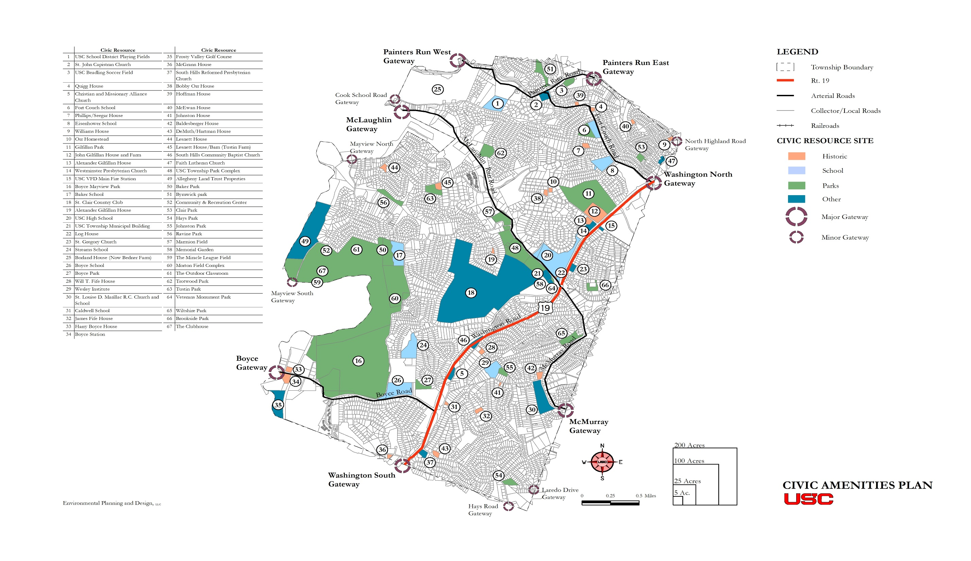

Slide 21
